Slide 1
Micro-Credit-Project

Slide 2
PROBLEM STATEMENT:
A Microfinance Institution (MFI) is an organization that offers financial services to low income populations. MFS becomes very useful when targeting especially the unbanked poor families living in remote areas with not much sources of income. The Microfinance services (MFS) provided by MFI are Group Loans, Agricultural Loans, Individual Business Loans and so on.
Many microfinance institutions (MFI), experts and donors are supporting the idea of using mobile financial services (MFS) which they feel are more convenient and efficient, and cost saving, than the traditional high-touch model used since long for the purpose of delivering microfinance services. Though, the MFI industry is primarily focusing on low income families and are very useful in such areas, the implementation of MFS has been uneven with both significant challenges and successes.
Today, microfinance is widely accepted as a poverty-reduction tool, representing $70 billion in outstanding loans and a global outreach of 200 million clients.
We are working with one such client that is in Telecom Industry. They are a fixed wireless telecommunications network provider. They have launched various products and have developed its business and organization based on the budget operator model, offering better products at Lower Prices to all value conscious customers through a strategy of disruptive innovation that focuses on the subscriber.

Slide 3
PROBLEM STATEMENT:
They understand the importance of communication and how it affects a person’s life, thus, focusing on providing their services and products to low income families and poor customers that can help them in the need of hour.
They are collaborating with an MFI to provide micro-credit on mobile balances to be paid back in 5 days. The Consumer is believed to be defaulter if he deviates from the path of paying back the loaned amount within the time duration of 5 days. For the loan amount of 5 (in Indonesian Rupiah), payback amount should be 6 (in Indonesian Rupiah), while, for the loan amount of 10 (in Indonesian Rupiah), the payback amount should be 12 (in Indonesian Rupiah).
The sample data is provided to us from our client database. It is hereby given to you for this exercise. In order to improve the selection of customers for the credit, the client wants some predictions that could help them in further investment and improvement in selection of customers.

Slide 4
Business Goal:
After collecting the data, you need to build a machine learning model. Before model building do all data pre-processing steps. Try different models with different hyper parameters and select the best model.
Follow the complete life cycle of data science. Include all the steps like.
1. Data Cleaning
2. Exploratory Data Analysis
3. Data Pre-processing
4. Model Building
5. Model Evaluation
6. Selecting the best model

Slide 5
Points to Remember:
There are no null values in the dataset.
There may be some customers with no loan history.
The dataset is imbalanced. Label ‘1’ has approximately 87.5% records, while, label ‘0’ has approximately 12.5% records.
For some features, there may be values which might not be realistic. You may have to observe them and treat them with a suitable explanation.
You might come across outliers in some features which you need to handle as per your understanding. Keep in mind that data is expensive and we cannot lose more than 7-8% of the data.

Slide 6
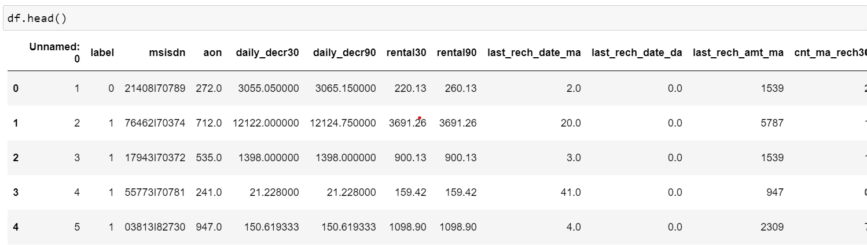
ABOUT THE DATASET:
Using various methods like df.shape, df.columns, df.head(), df.tail() , df.info() to get some idea about the data we are handling

Slide 7
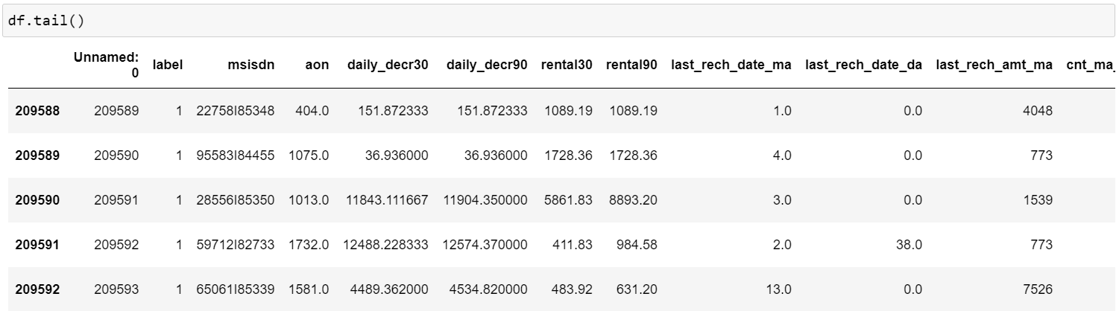
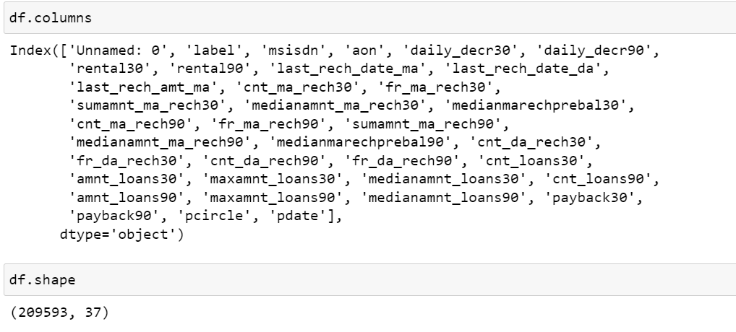
ABOUT THE DATASET:

Slide 8
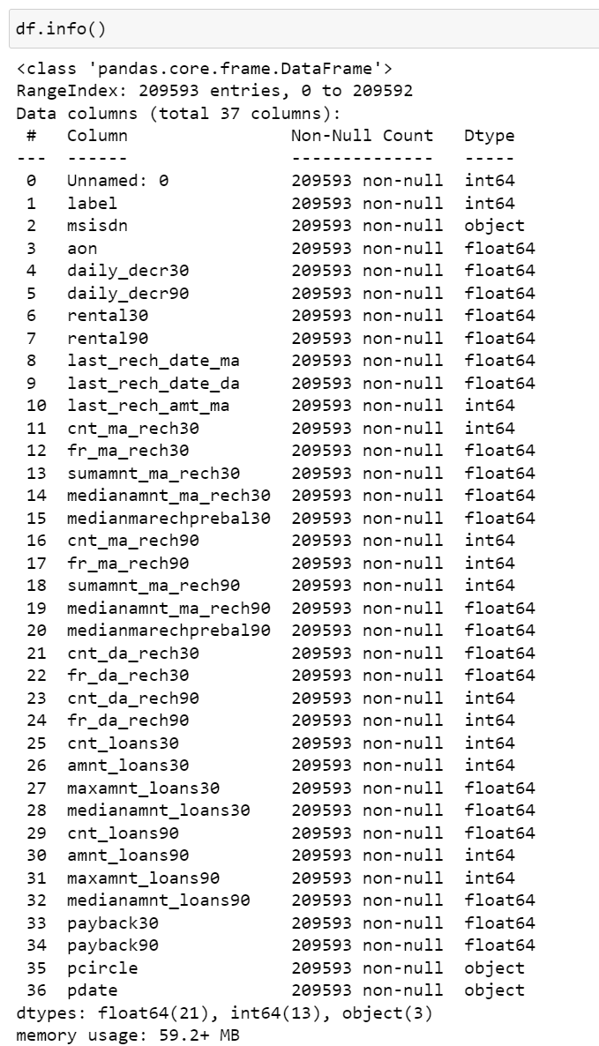
ABOUT THE DATASET:

Slide 9
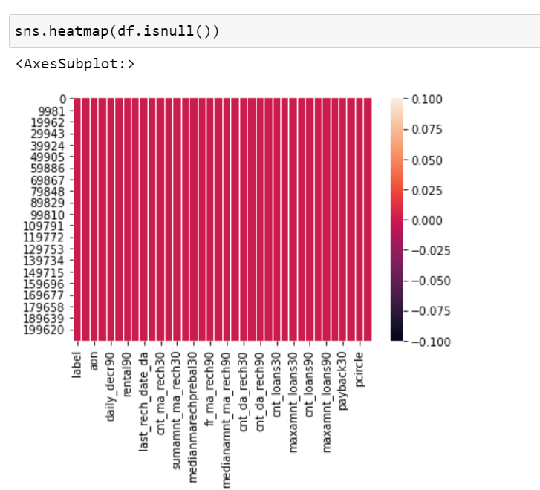
NULL VALUE CHECK:
Checking null values present in data by heatmap

Slide 10
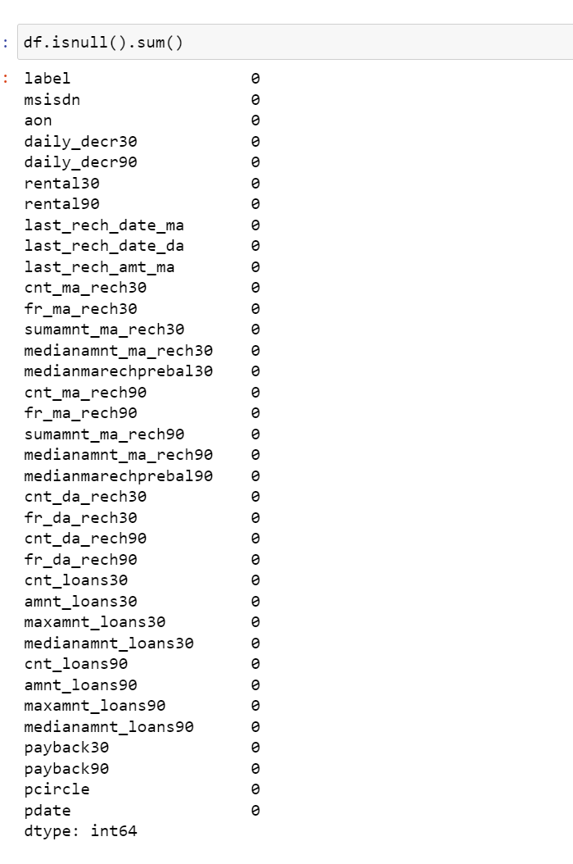
NULL VALUE TREATMENT:

Slide 11
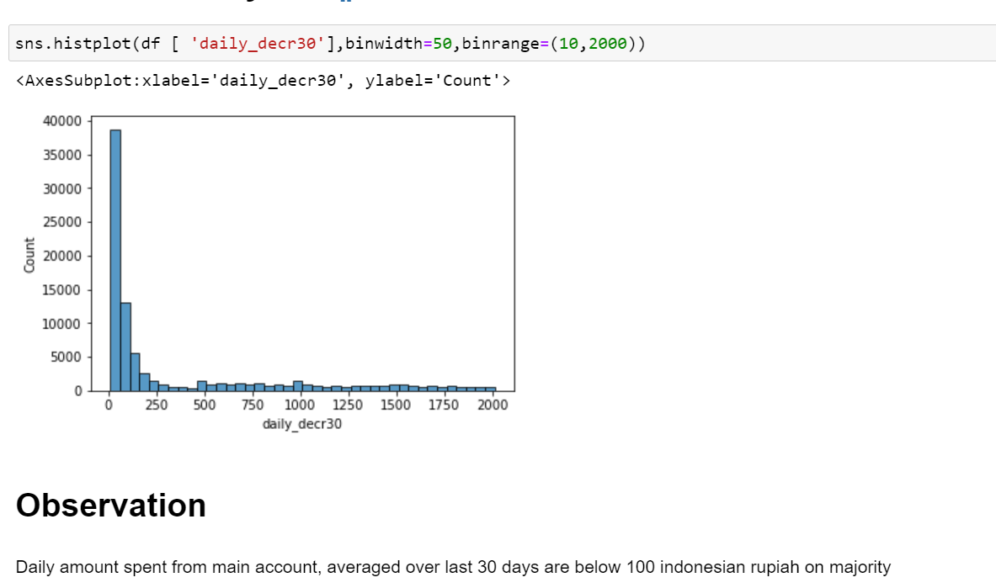
UNIVARIATE ANALYSIS:

Slide 12
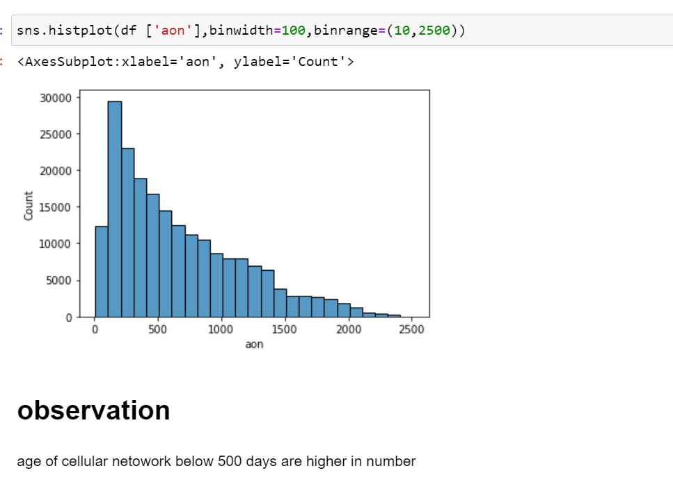
UNIVARIATE ANALYSIS:

Slide 13
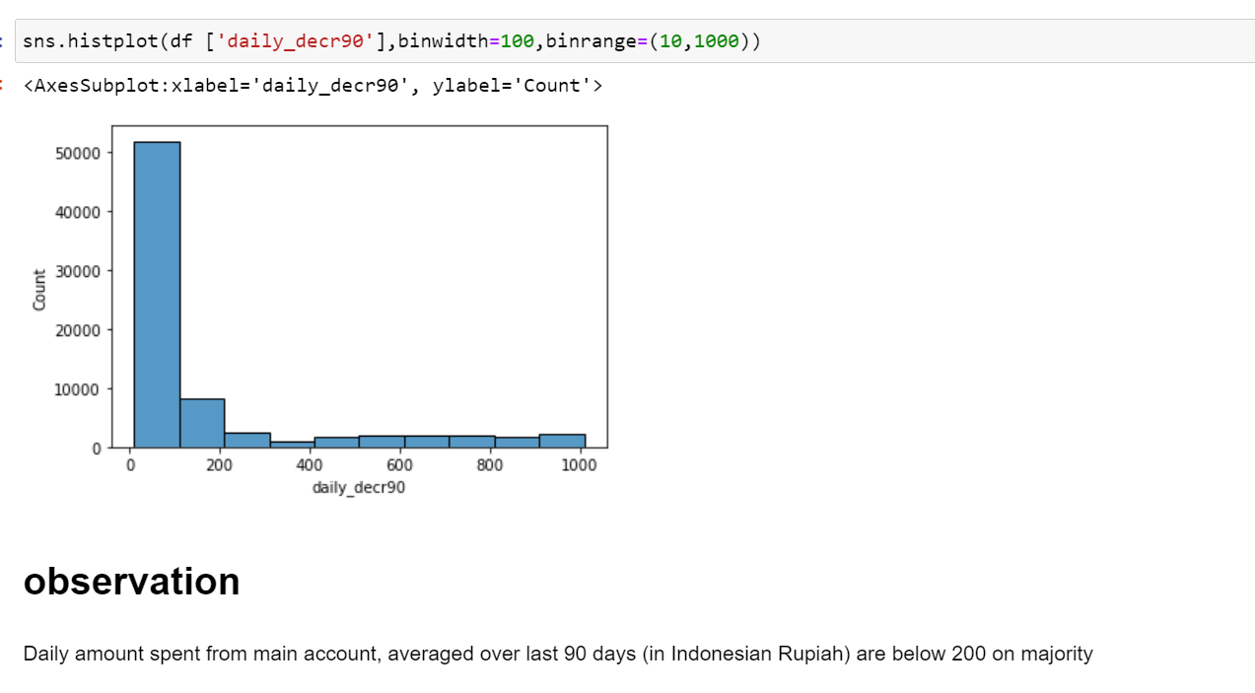
UNIVARIATE ANALYSIS:

Slide 14
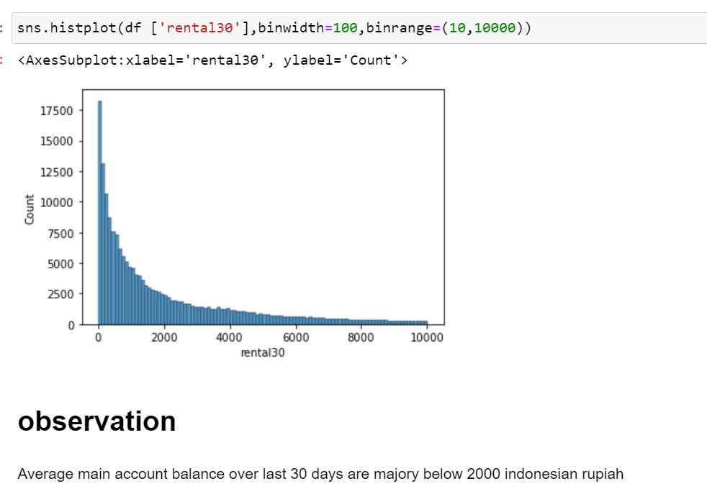
UNIVARIATE ANALYSIS:

Slide 15
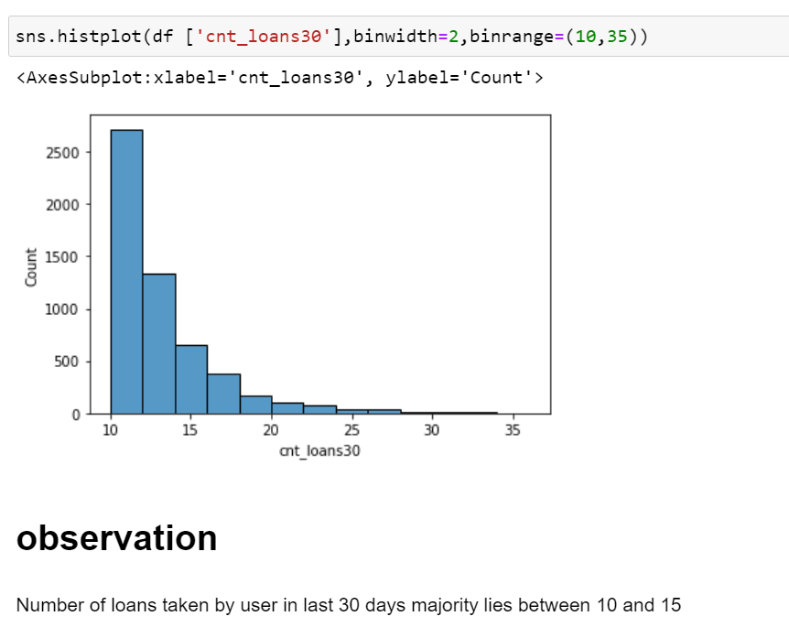
UNIVARIATE ANALYSIS:

Slide 16
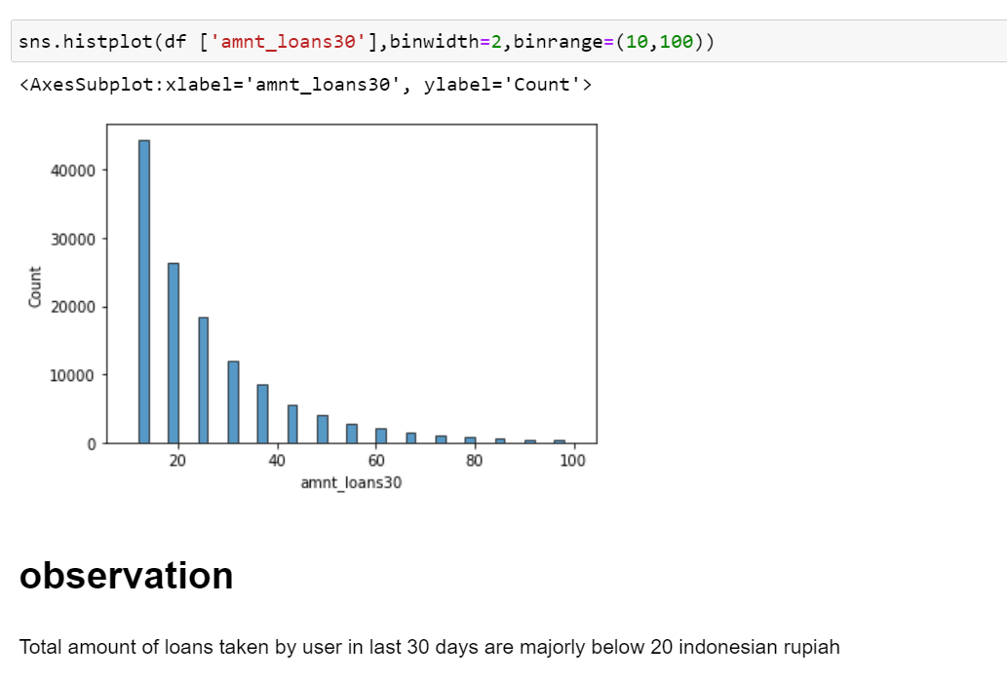
UNIVARIATE ANALYSIS:

Slide 17
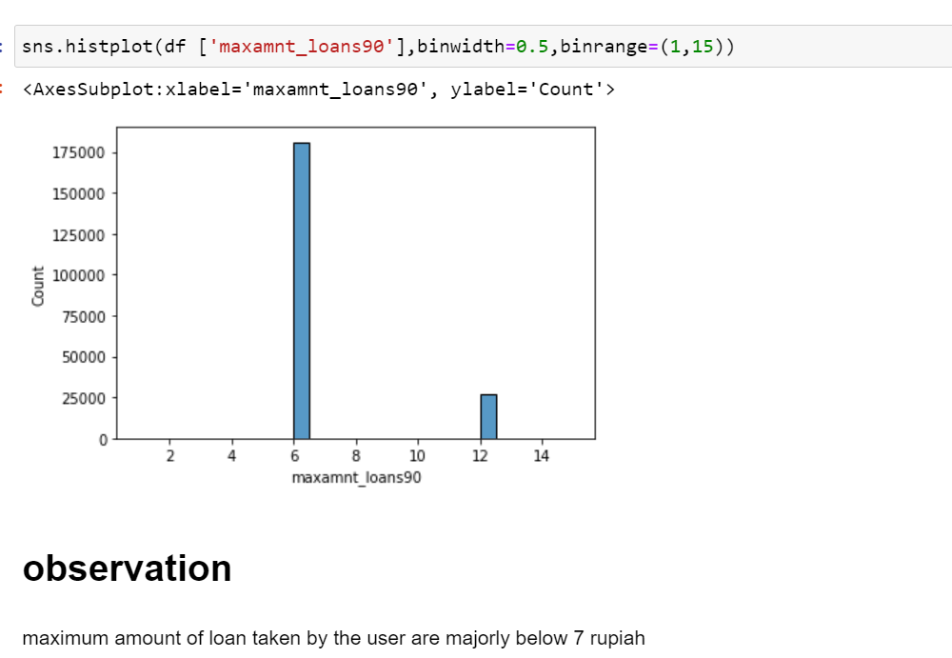
UNIVARIATE ANALYSIS:

Slide 18
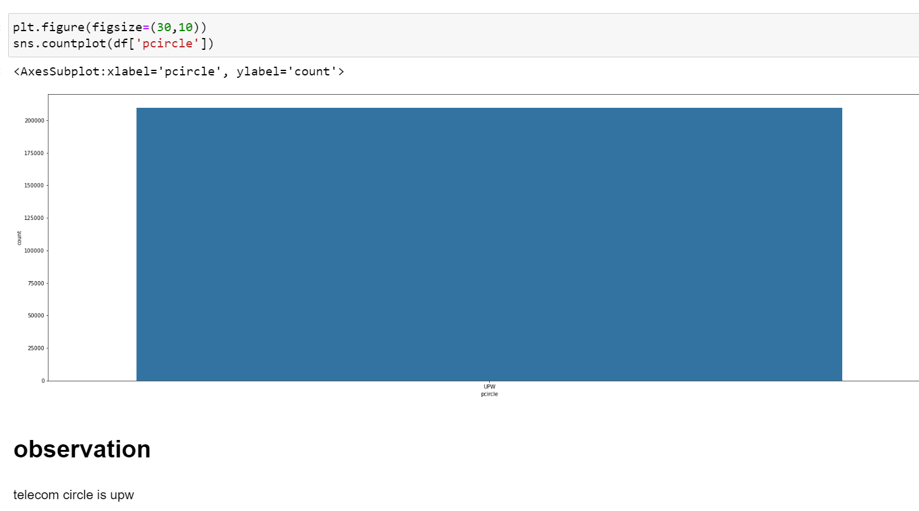
UNIVARIATE ANALYSIS:

Slide 19
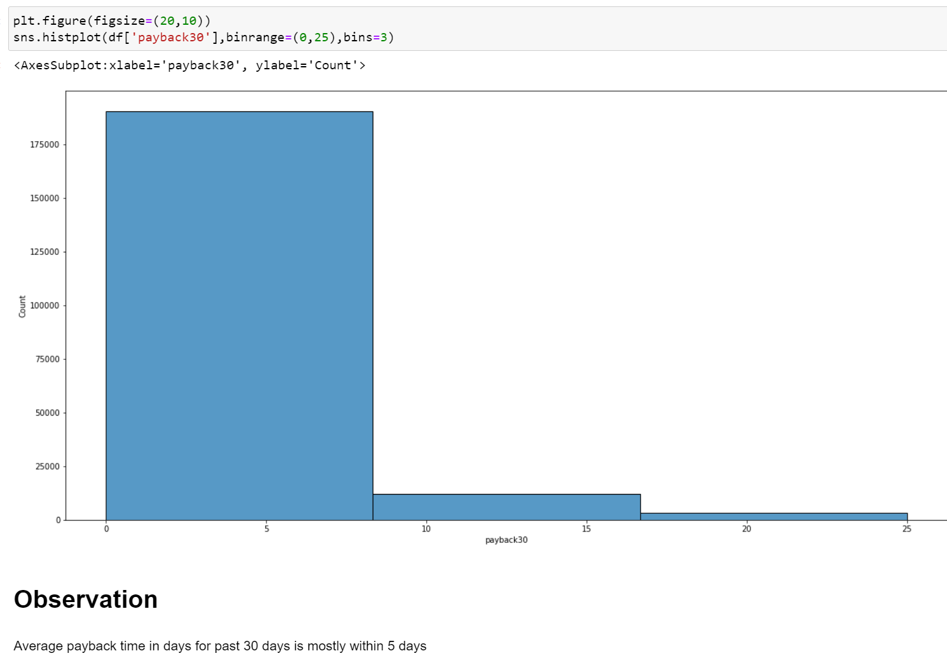
UNIVARIATE ANALYSIS:

Slide 20
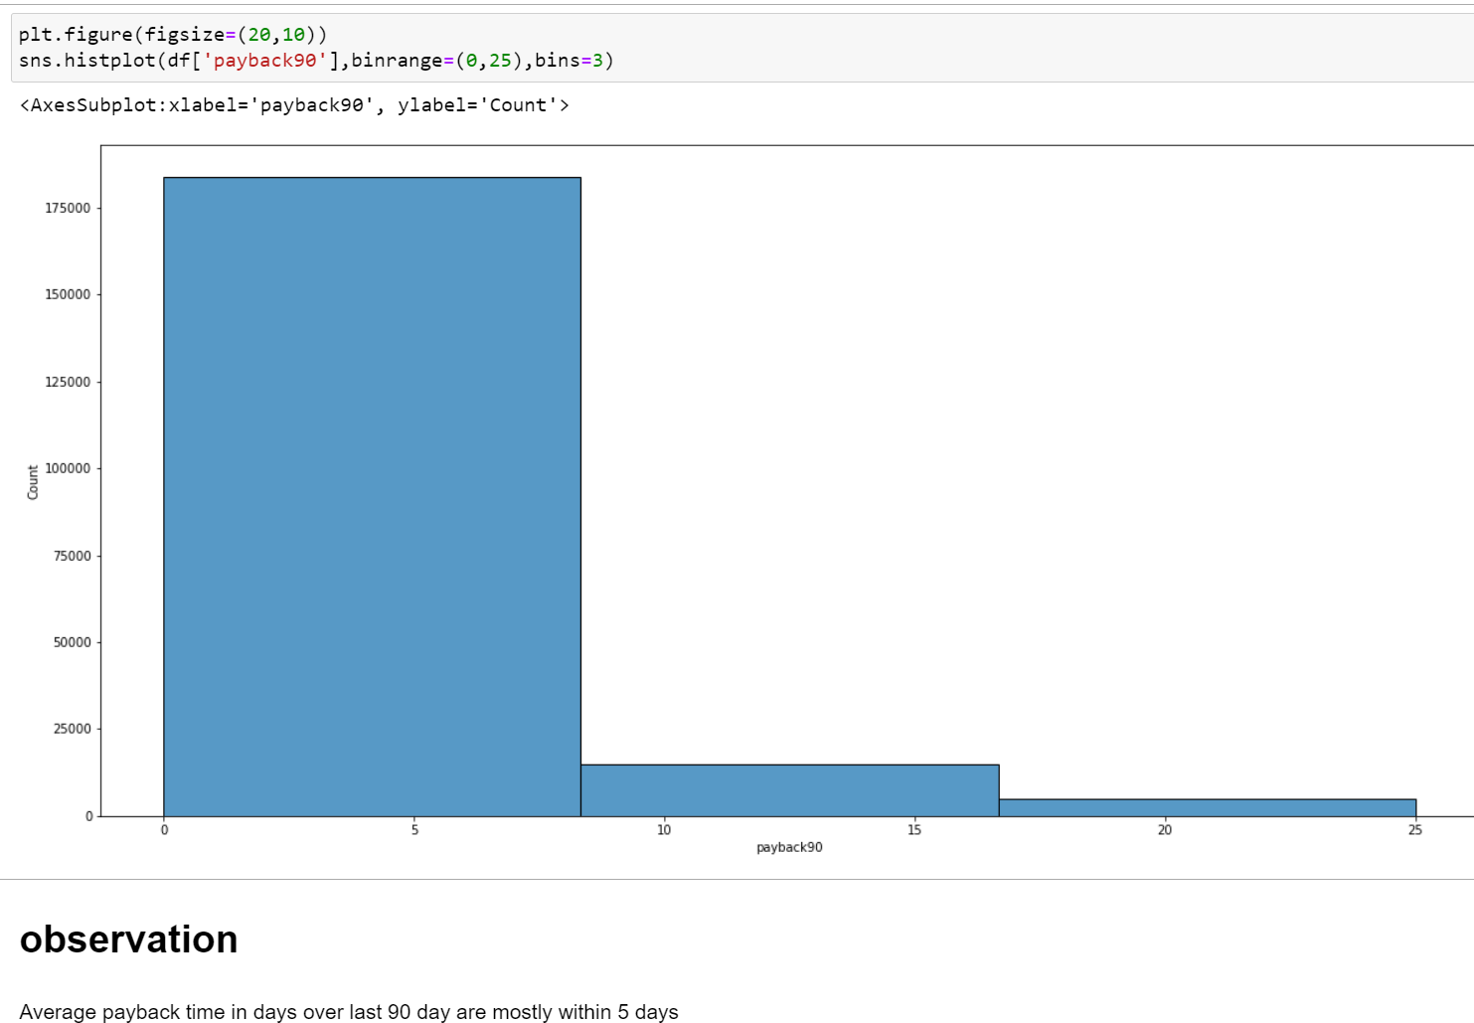
UNIVARIATE ANALYSIS:

Slide 21
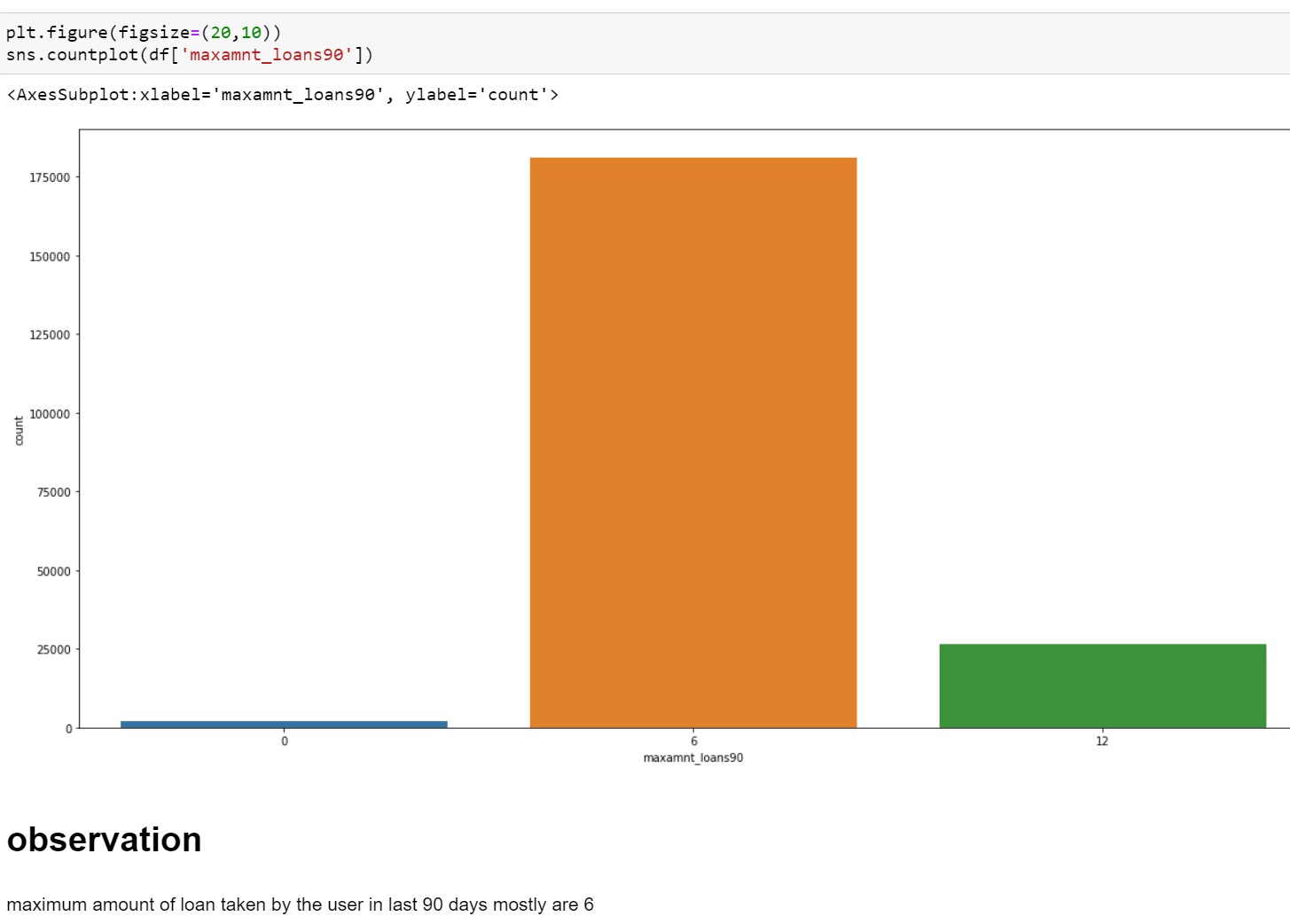
UNIVARIATE ANALYSIS:

Slide 22
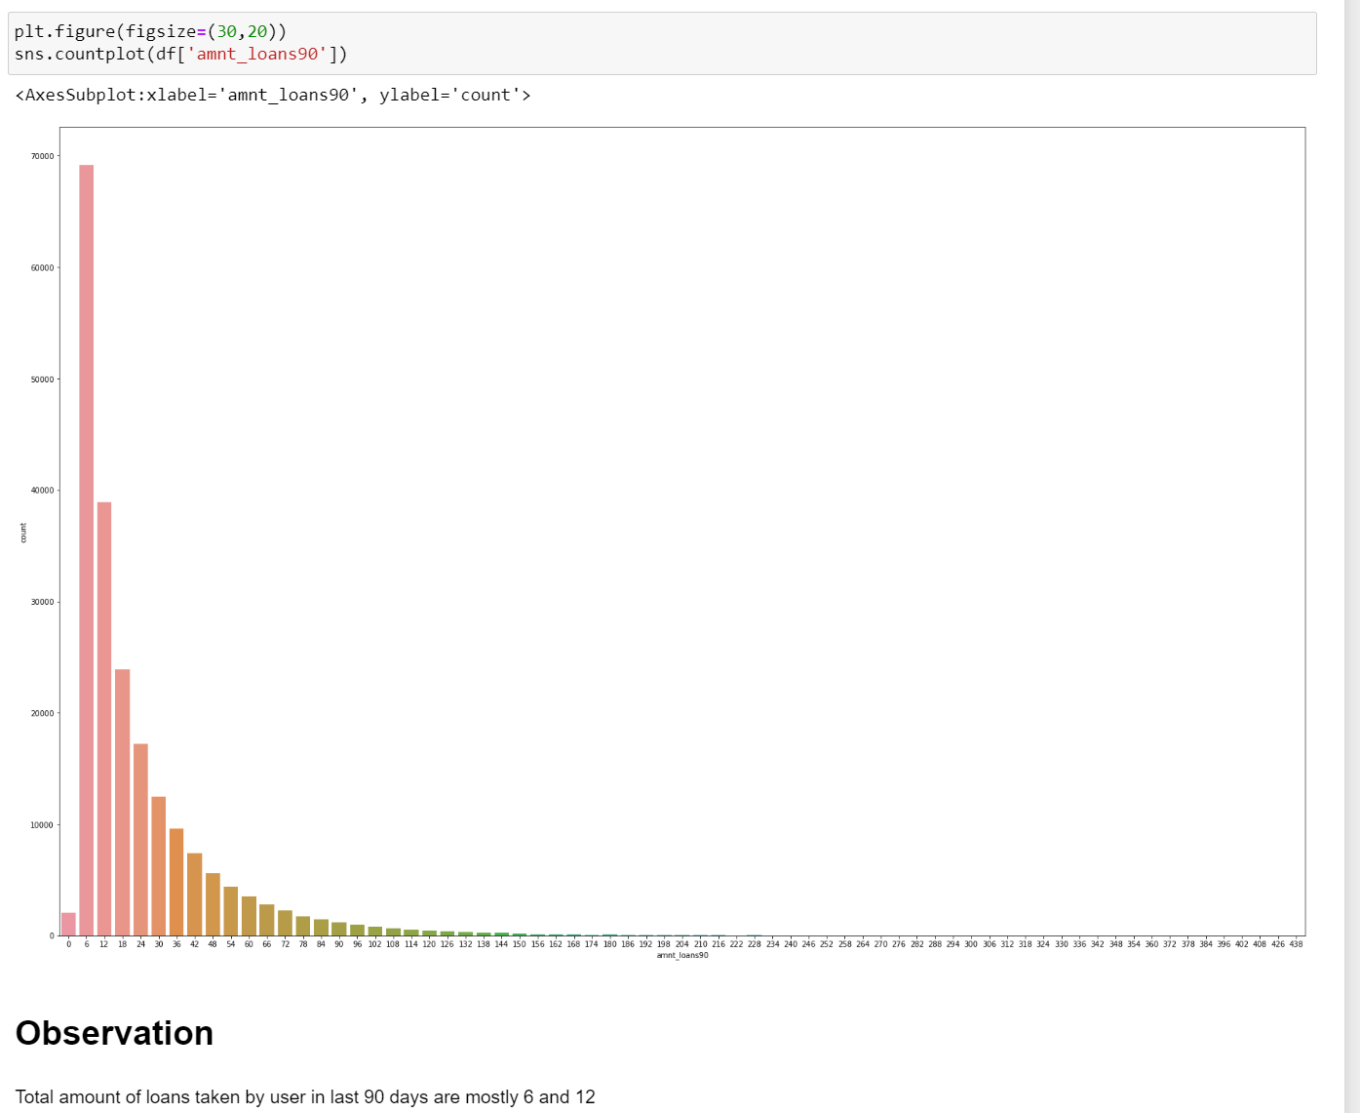
UNIVARIATE ANALYSIS:

Slide 23
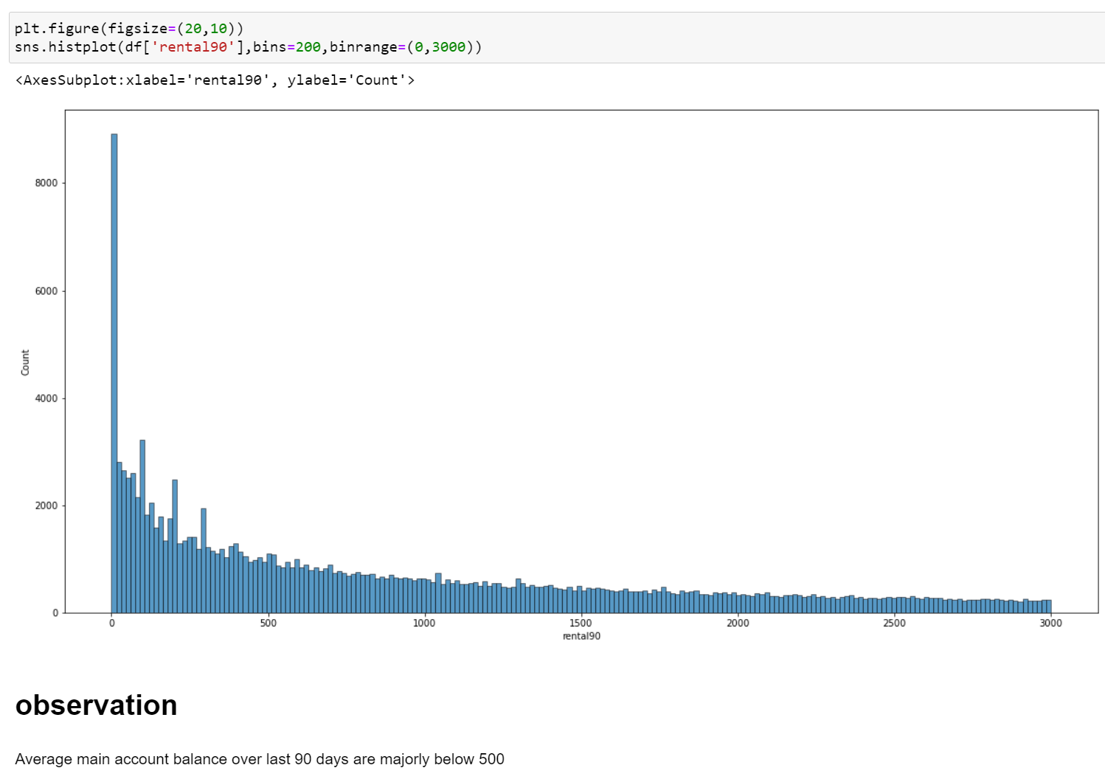
UNIVARIATE ANALYSIS:

Slide 24
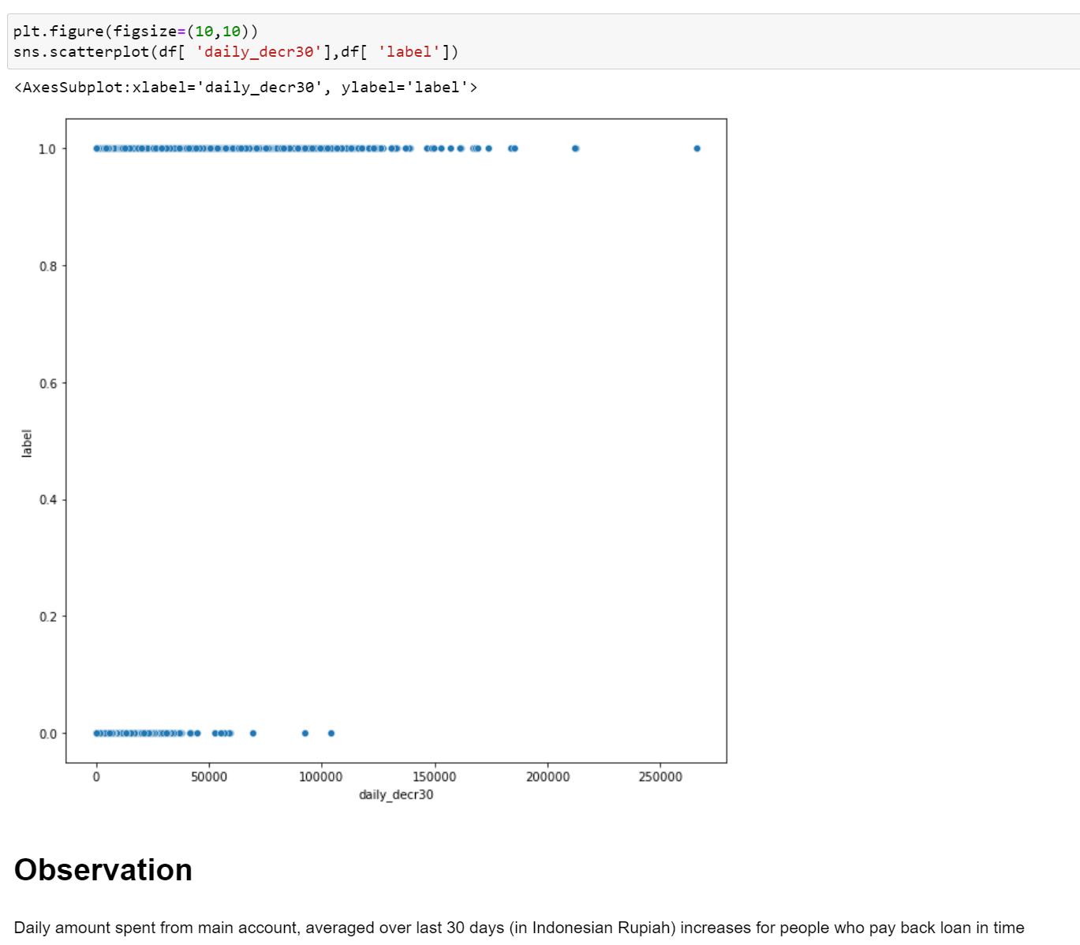
BIVARIATE ANALYSIS:

Slide 25
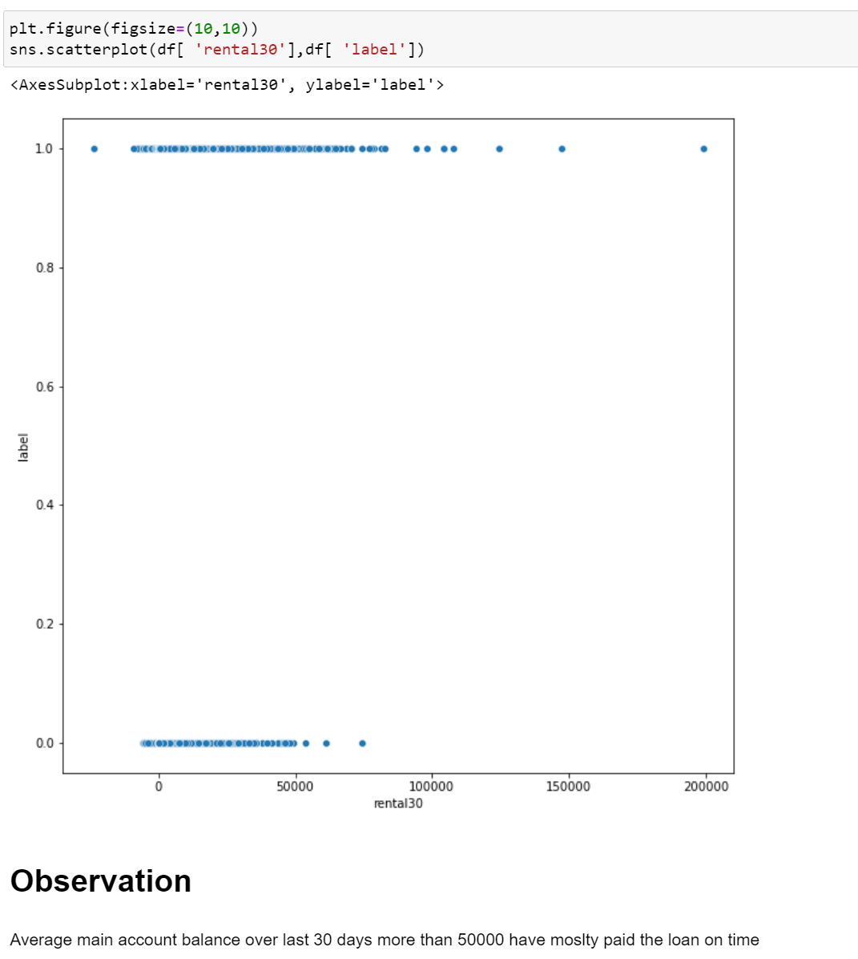
BIVARIATE ANALYSIS:

Slide 26
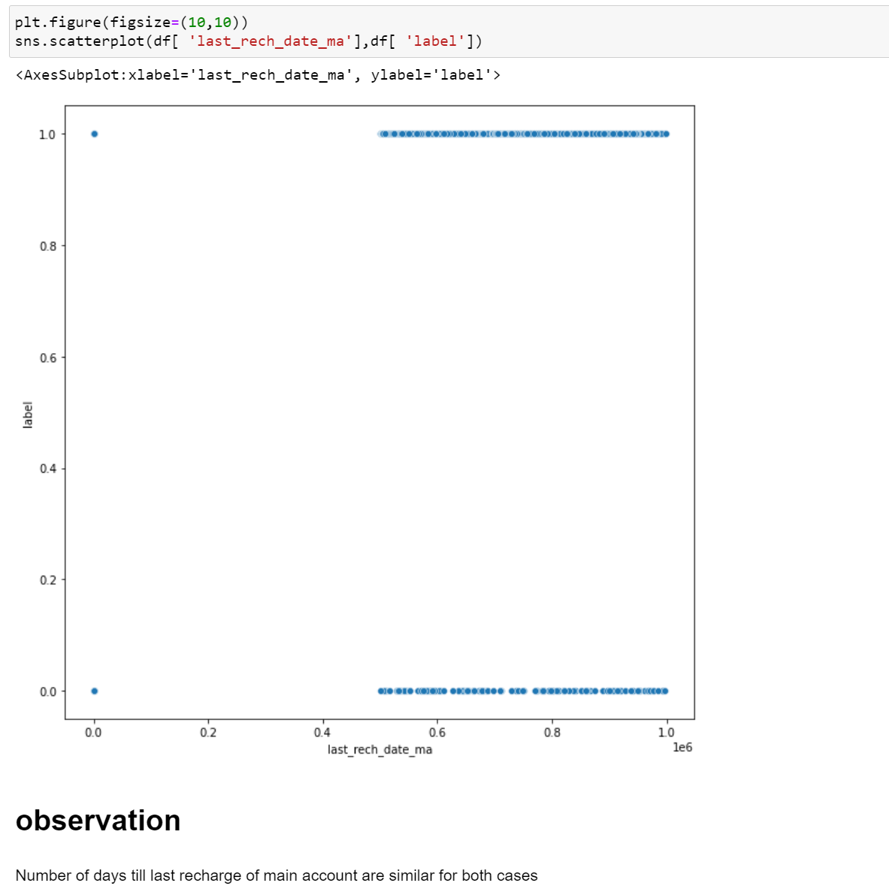
BIVARIATE ANALYSIS:

Slide 27
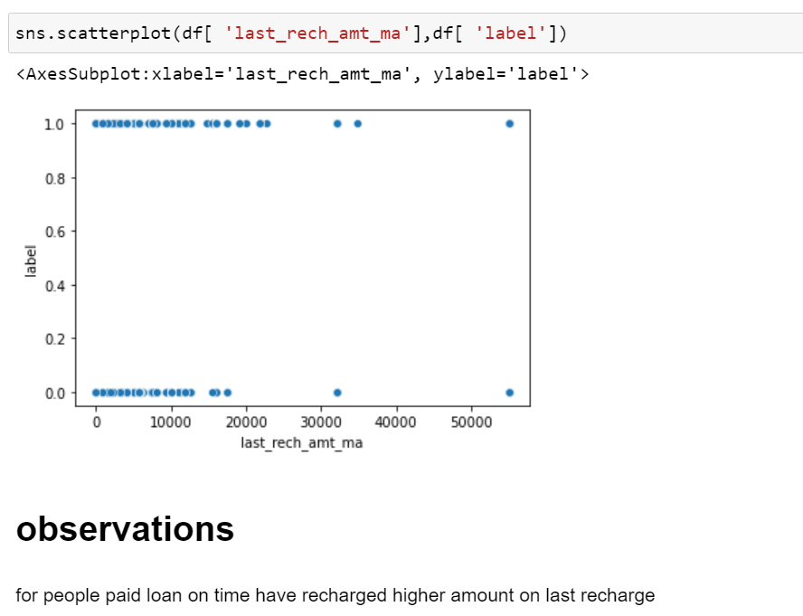
BIVARIATE ANALYSIS:

Slide 28
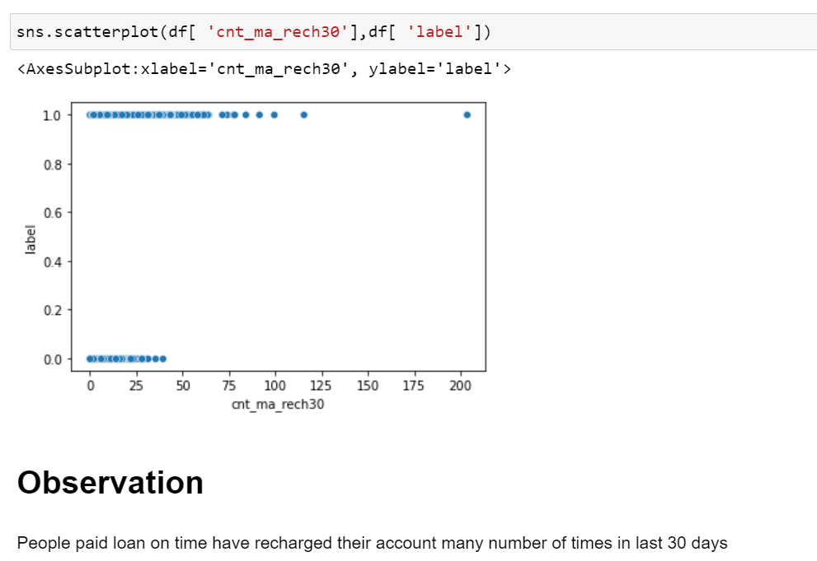
BIVARIATE ANALYSIS:

Slide 29
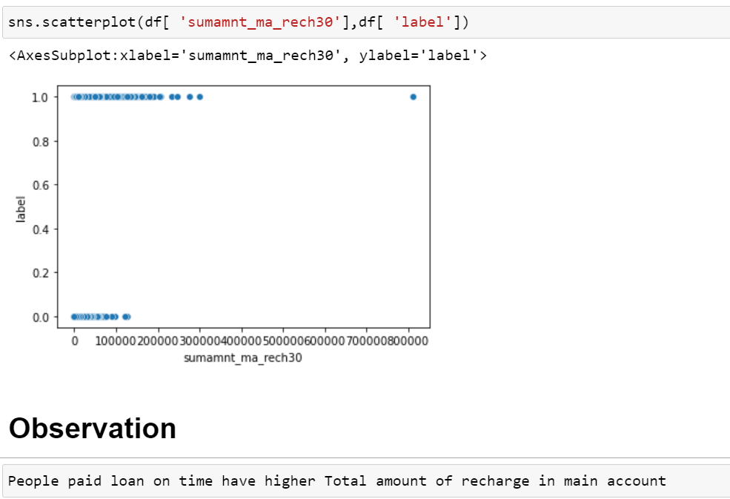
BIVARIATE ANALYSIS:

Slide 30
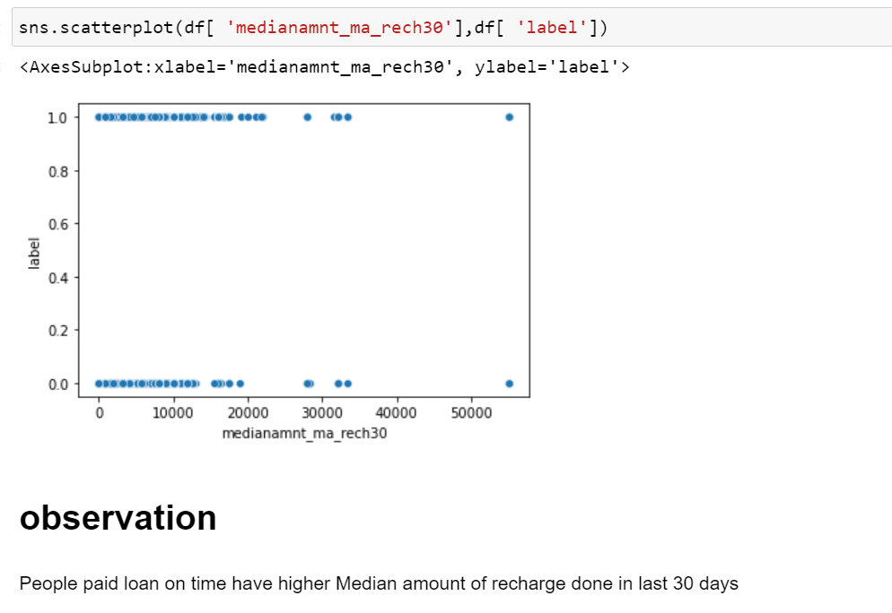
BIVARIATE ANALYSIS:

Slide 31
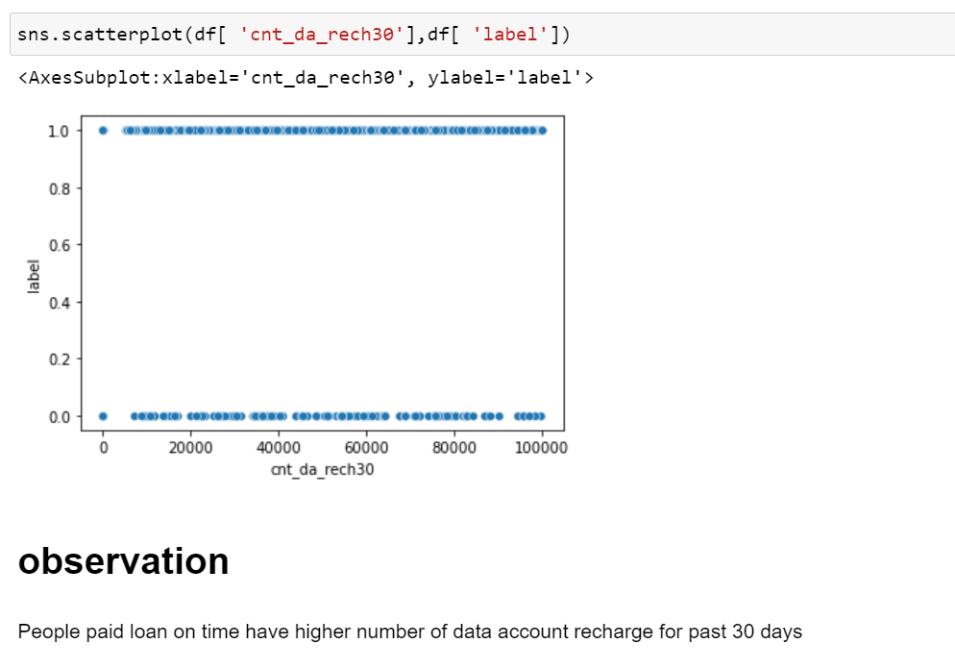
BIVARIATE ANALYSIS:

Slide 32
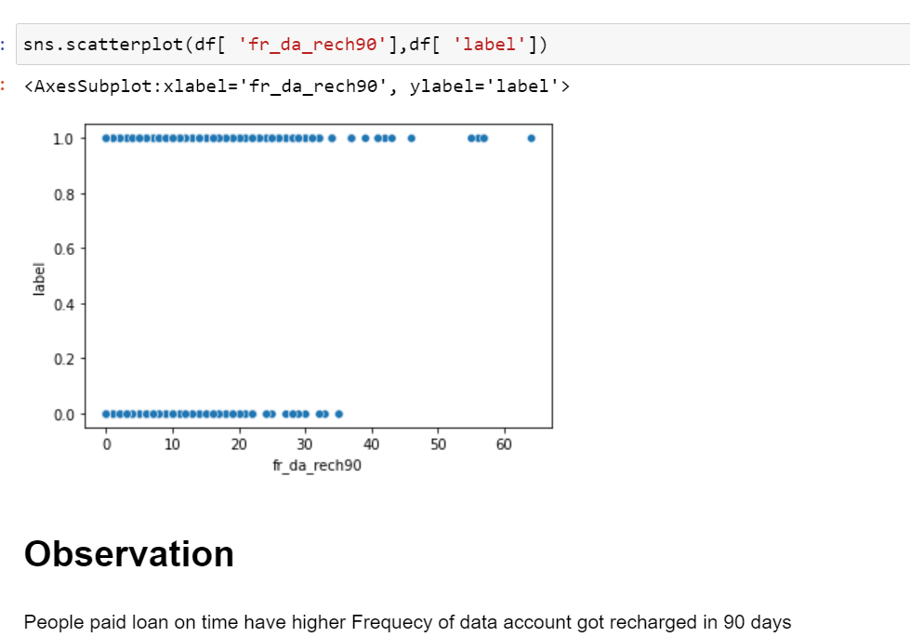
BIVARIATE ANALYSIS:

Slide 33
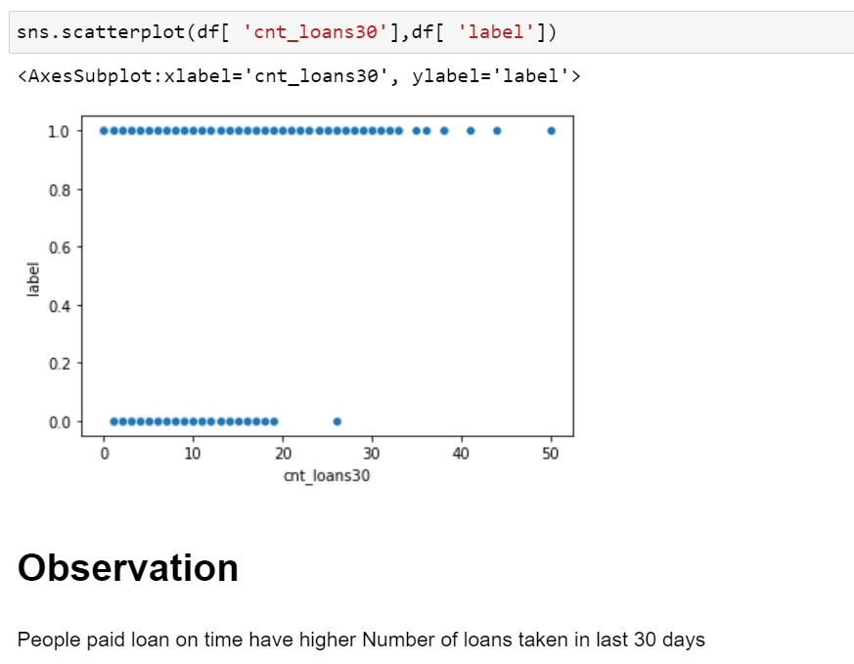
BIVARIATE ANALYSIS:

Slide 34
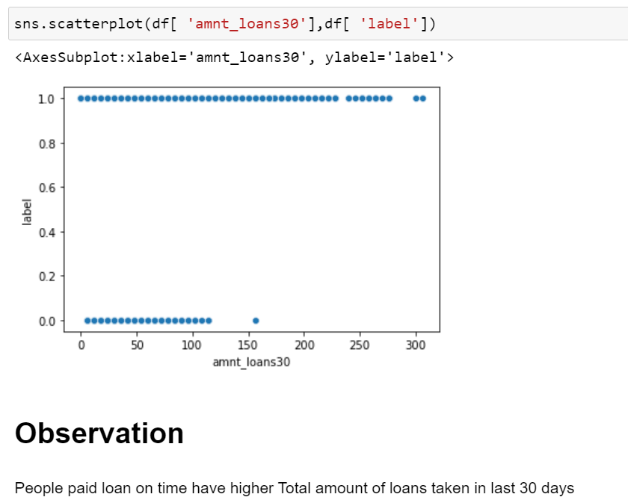
BIVARIATE ANALYSIS:

Slide 35
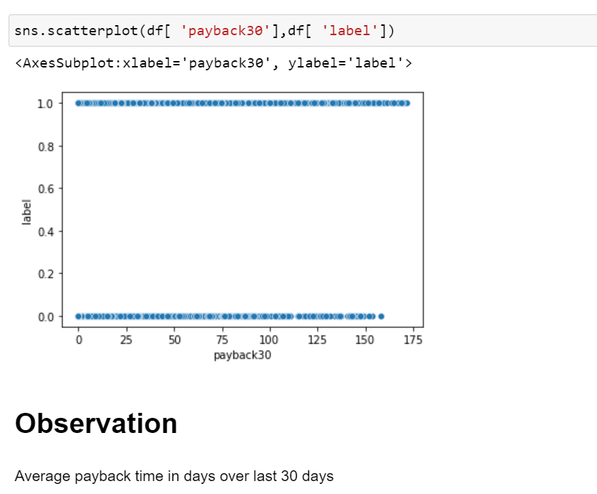
BIVARIATE ANALYSIS:

Slide 36
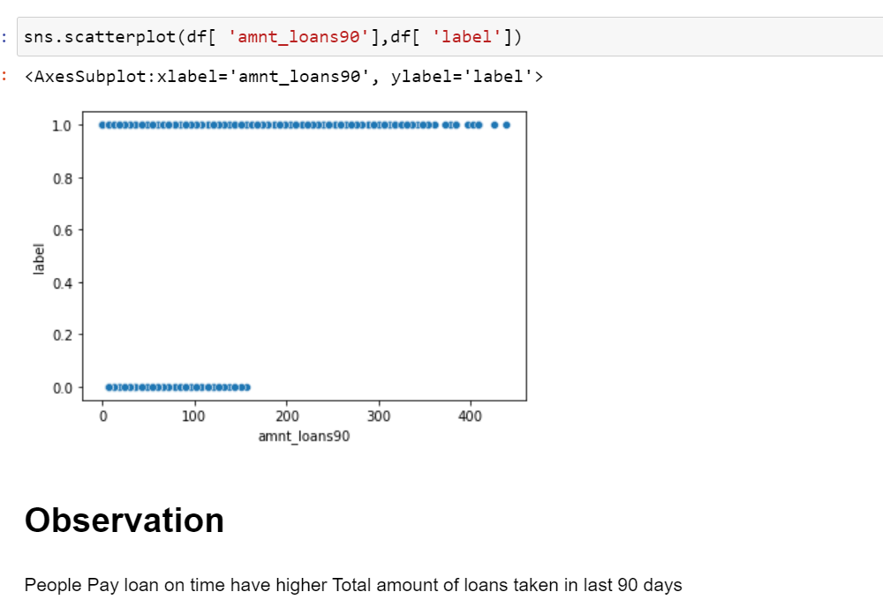
BIVARIATE ANALYSIS:

Slide 37
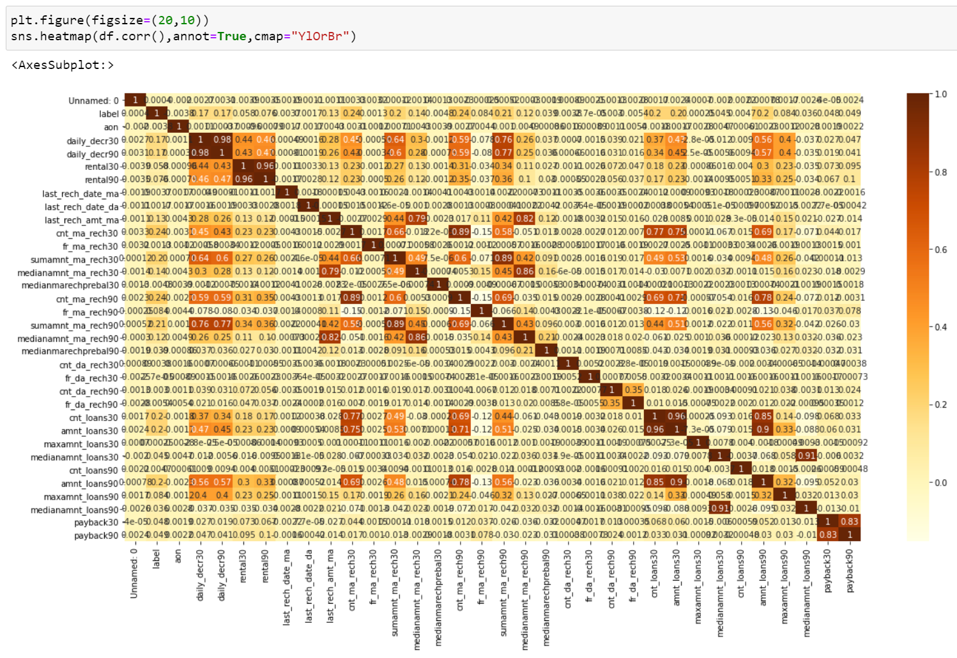
CORRELATION ANALYSIS:

Slide 38
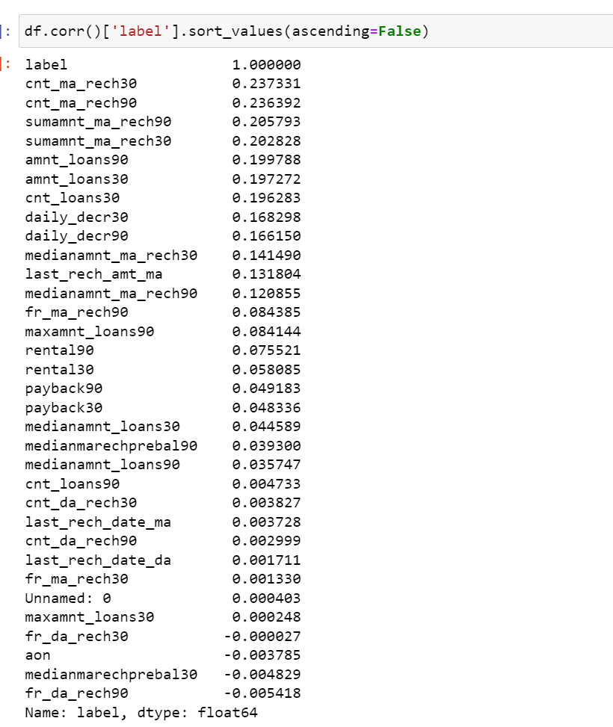
CORRELATION ANALYSIS:

Slide 39
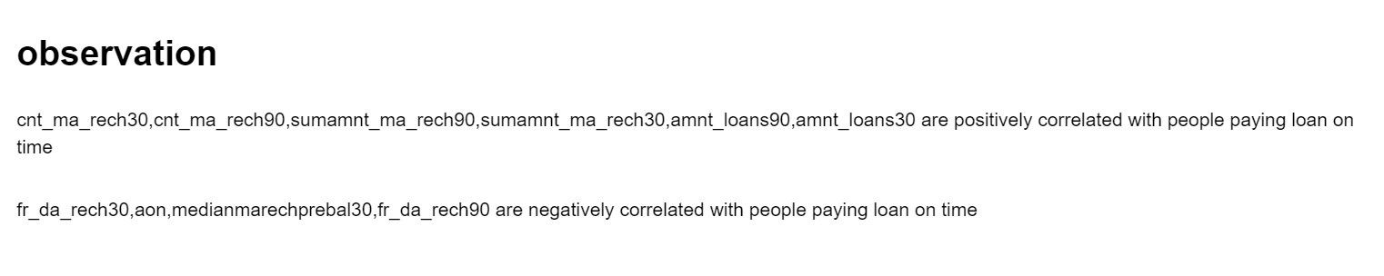
CORRELATION ANALYSIS:

Slide 40
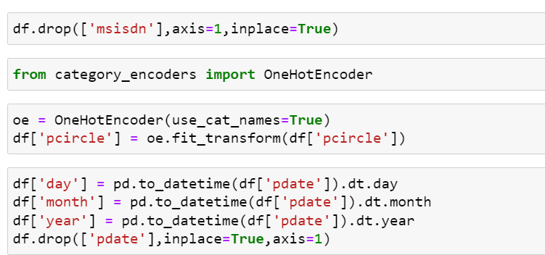
ENCODING
DATA CONTAINS OBJECT DATA SO WE ARE ENCODING WITH ONE HOT ENCODER METHOD AS DATA HAS NO ORDINAL RELATIONSHIP

Slide 41
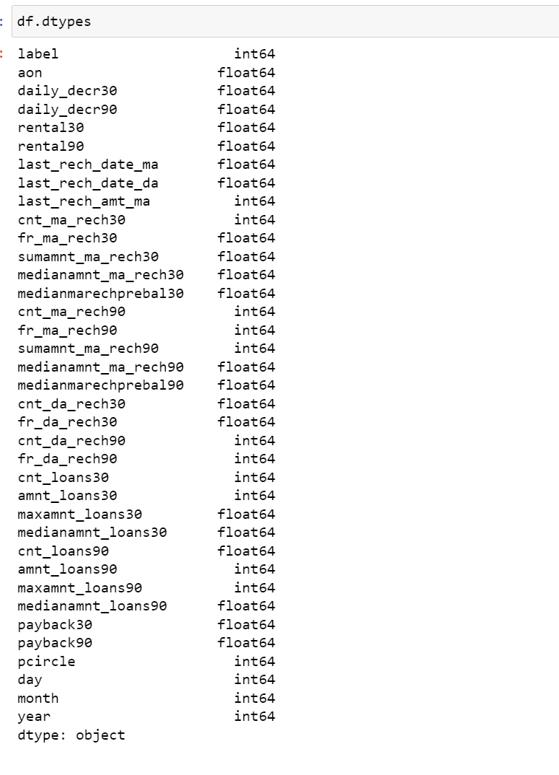
ENCODING:

Slide 42
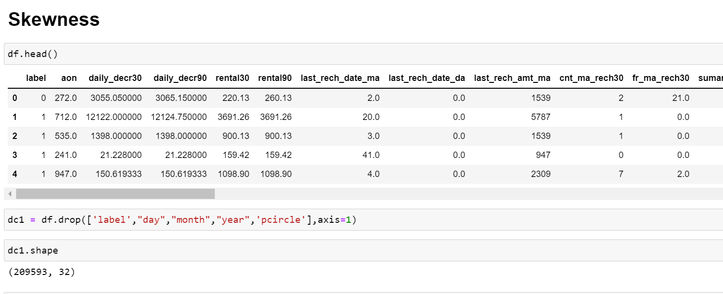
SKEWNESS:
We can see data have skewness so now we proceed to remove it
By using power_transform skewness in the data is removed

Slide 43
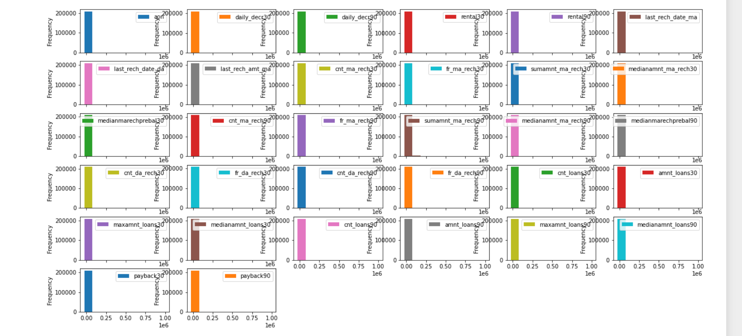
SKEWNESS:

Slide 44
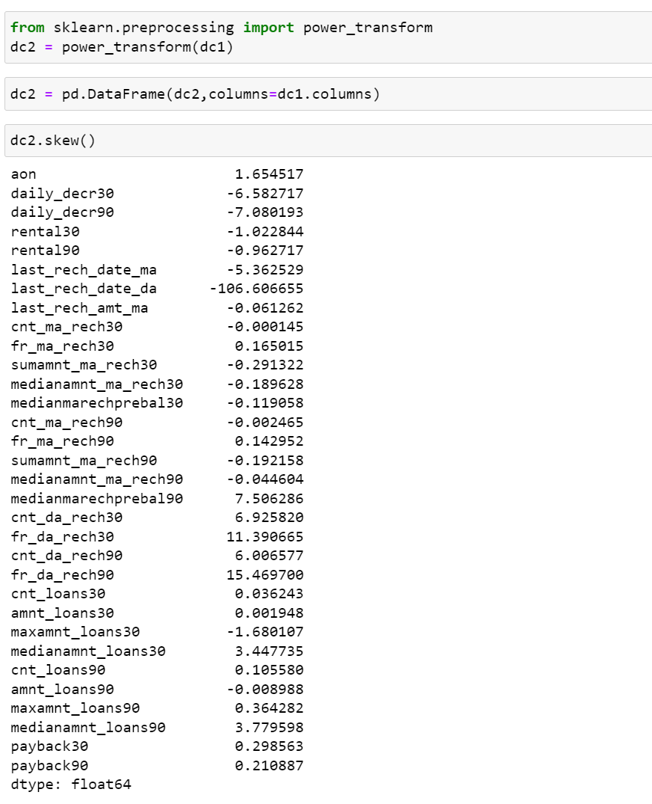
SKEWNESS:

Slide 45
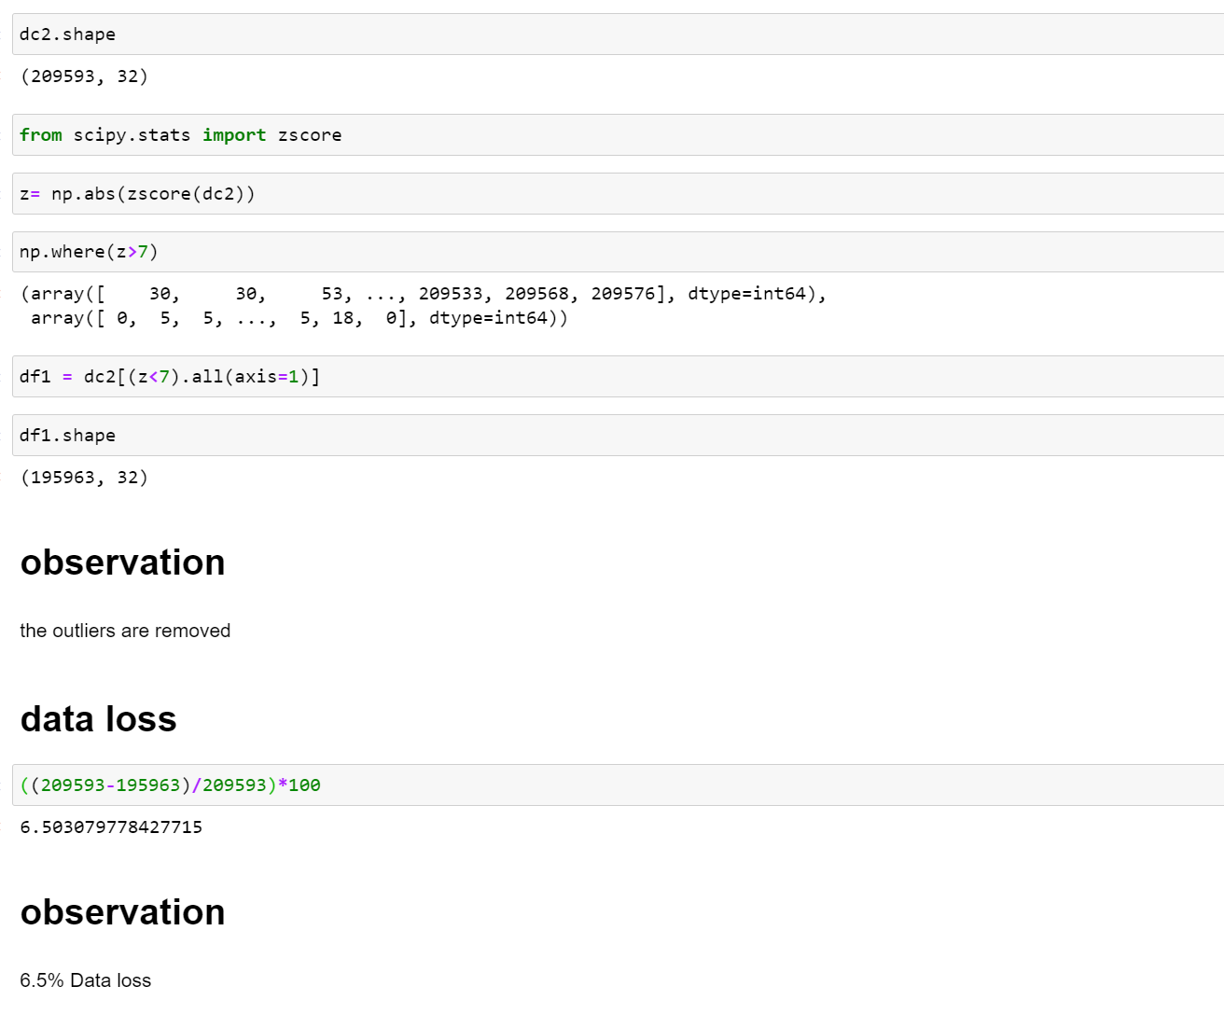
OUTLIERS:
We can see there are outliers in this data . So we use z score method to remove outliers.

Slide 46
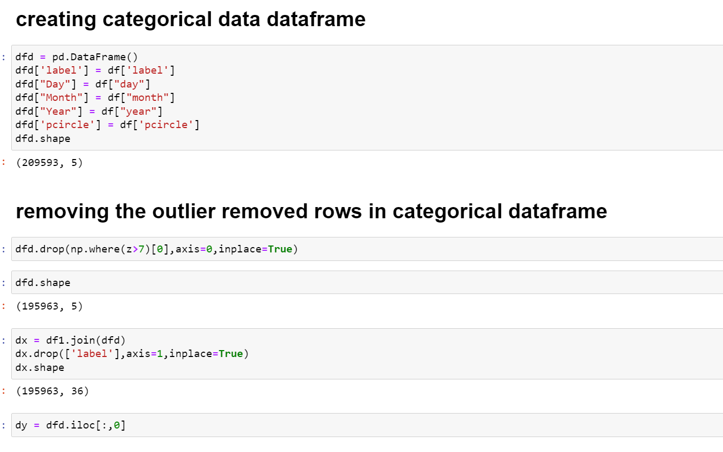

Slide 47
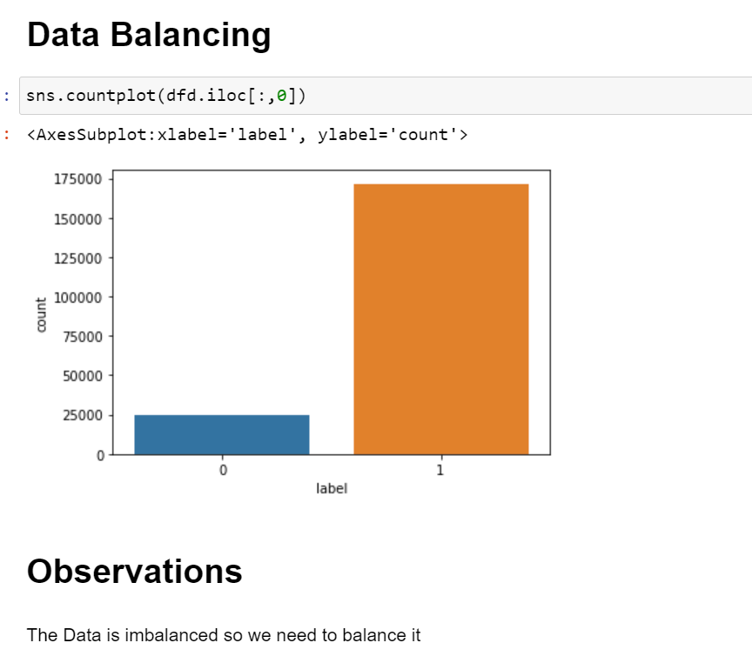

Slide 48
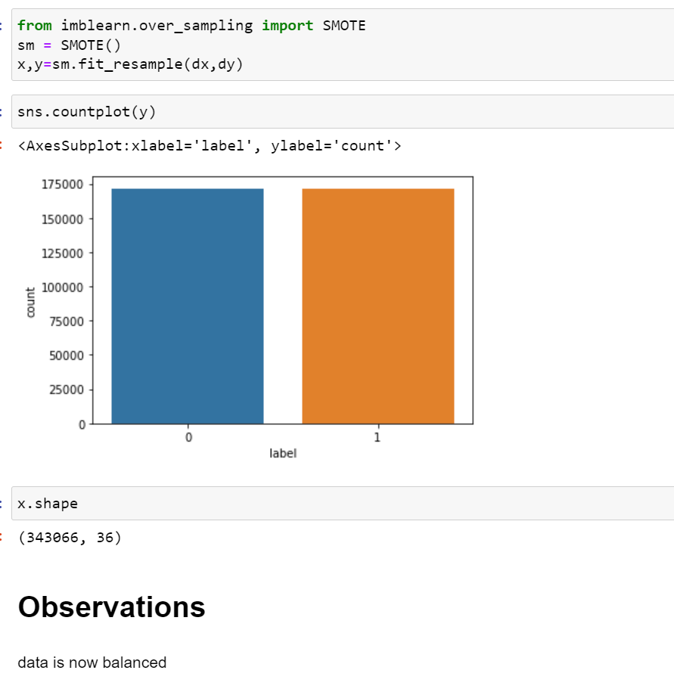
OUTLIERS:

Slide 49
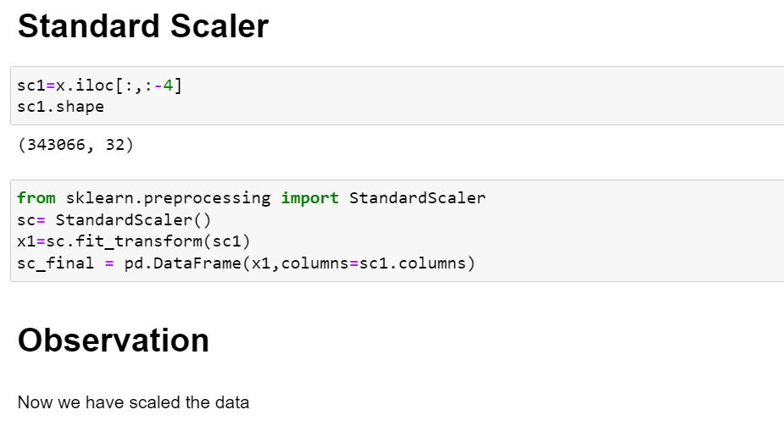

Slide 50
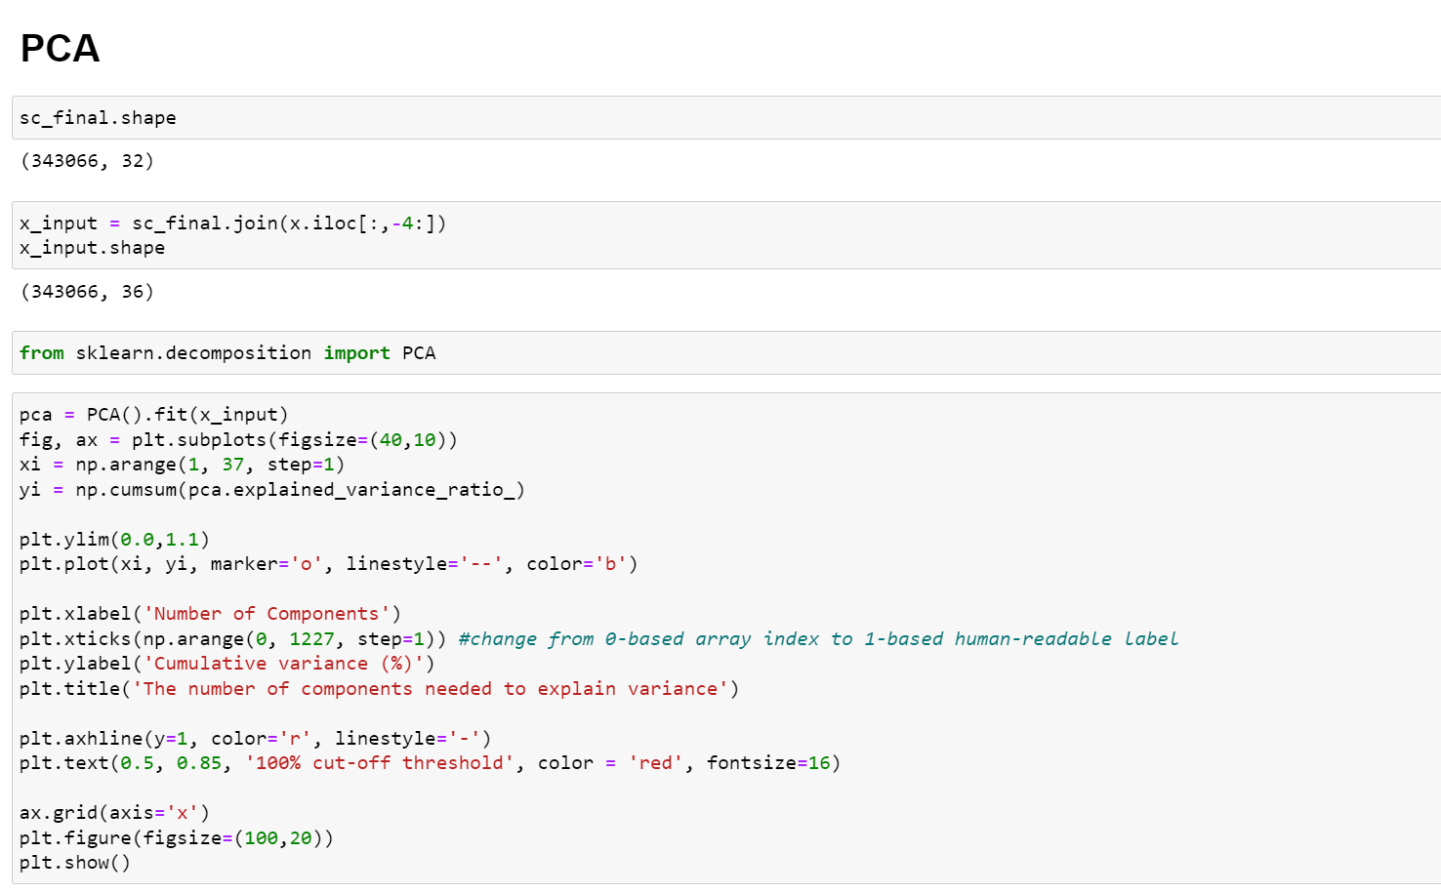

Slide 51
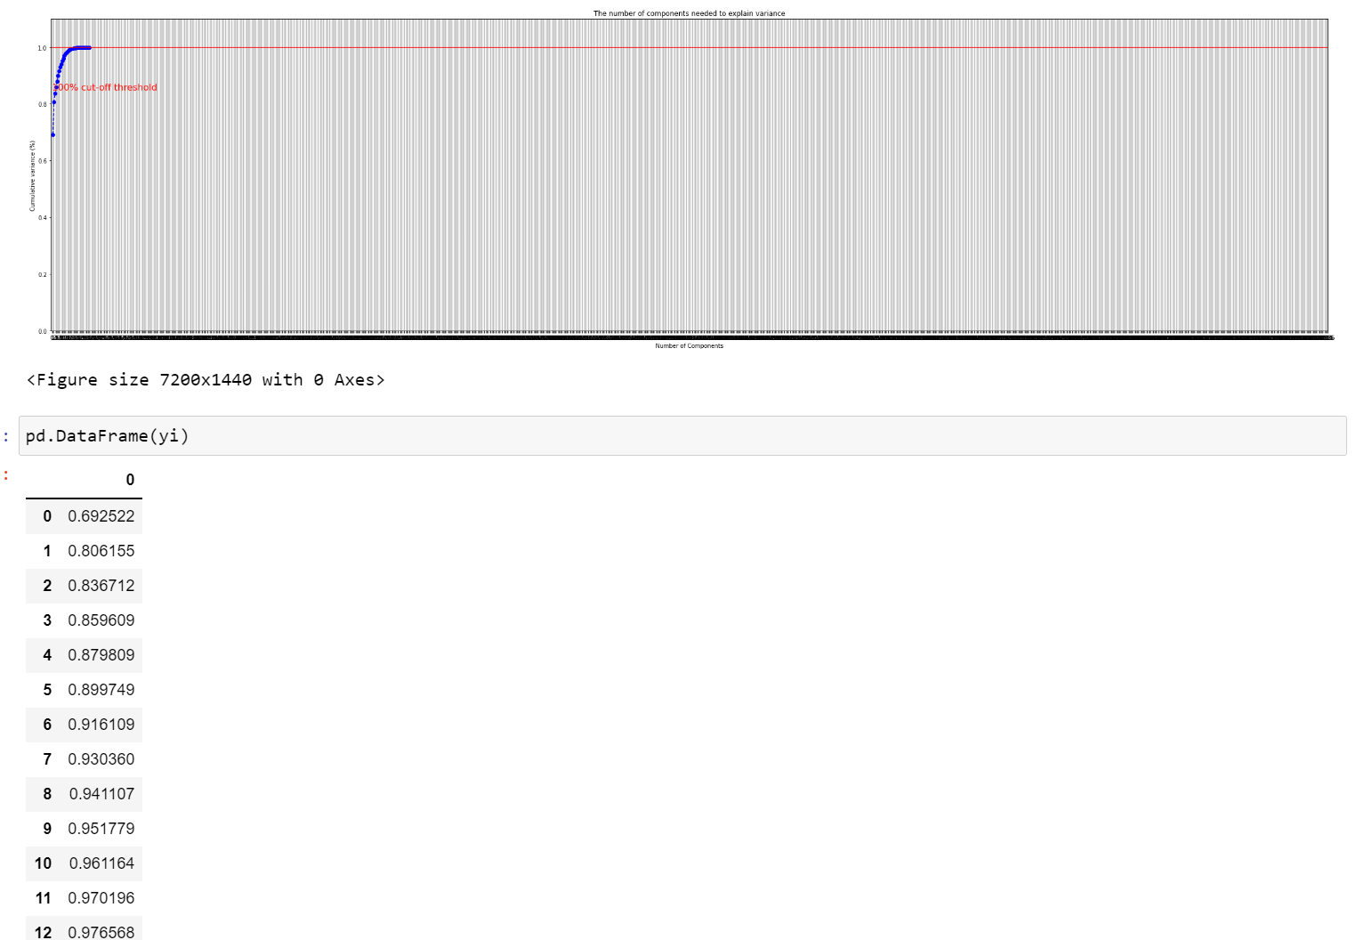
We need 29 columns to retain most of the information in data

Slide 52
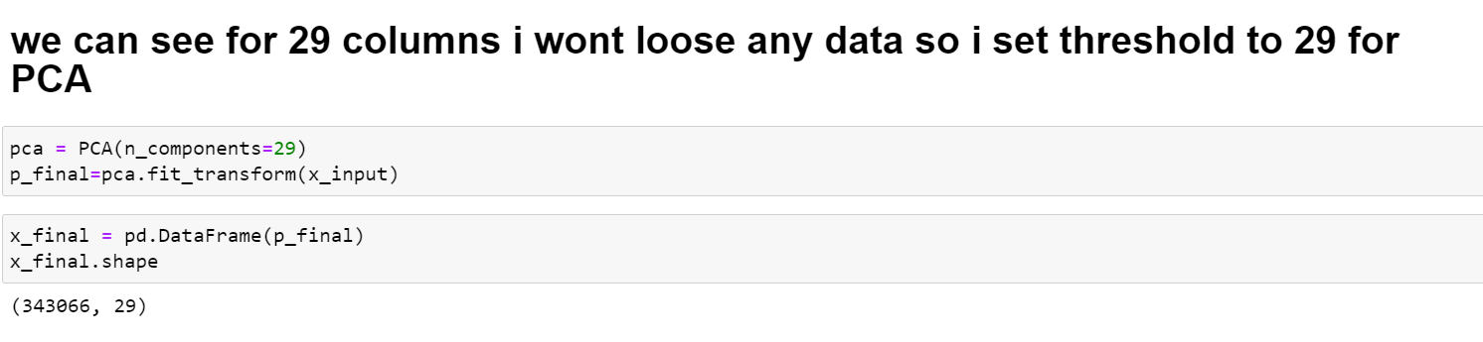

Slide 53
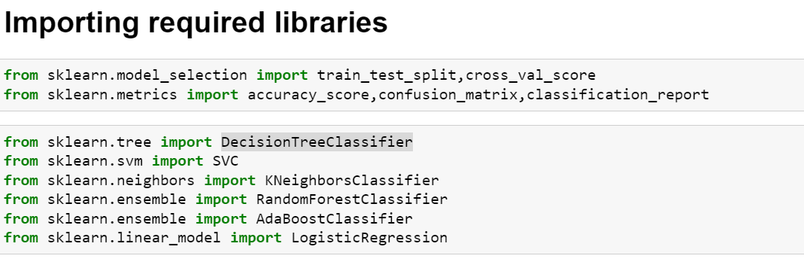
MODEL TRAINING

Slide 54
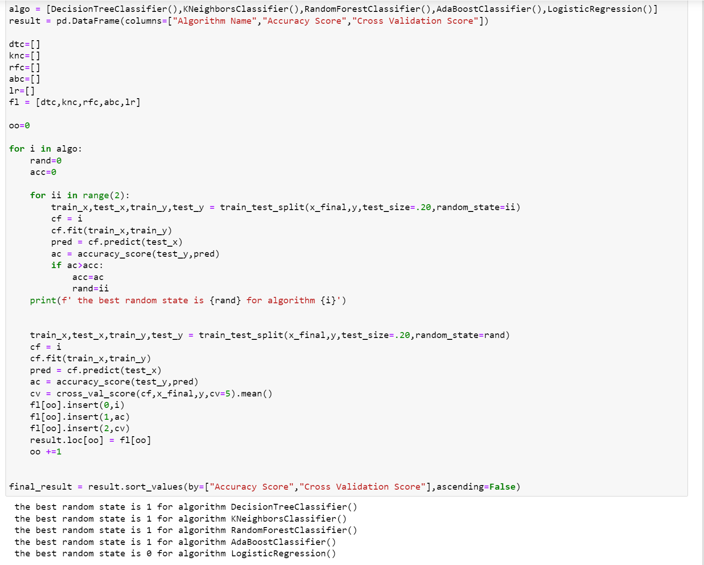
MODEL TRAINING

Slide 55

MODEL TRAINING
We can see random forest regressor performed best compared to other algorithms

Slide 56

HYPERPARAMETER TUNING

Slide 57


Slide 58


Slide 59


Slide 60
CONCLUSION
Key Findings And Conclusions Of The Study
We Can Clearly See The Person Who Most Likely To Pay Loan On Time Have Certain Traits. If Factors Like Daily Amount Spends From Main Account, Average Main Account Balance, No Of Times Account Recharged, No Of Times Data Account Recharged, No Of Times Loan Taken, Total Amount Of Loan These Increase He Is More Likely To Pay Loan On Time
Learning Outcomes Of The Study In Respect Of Data Science
Based On This Study We Can Identify Several Important Factors Which Help Us To Determine A Person Quality To Pay Loan On Time.

Slide 61
THANK YOU FOR THE OPPORTUNITY :

